Slide 1
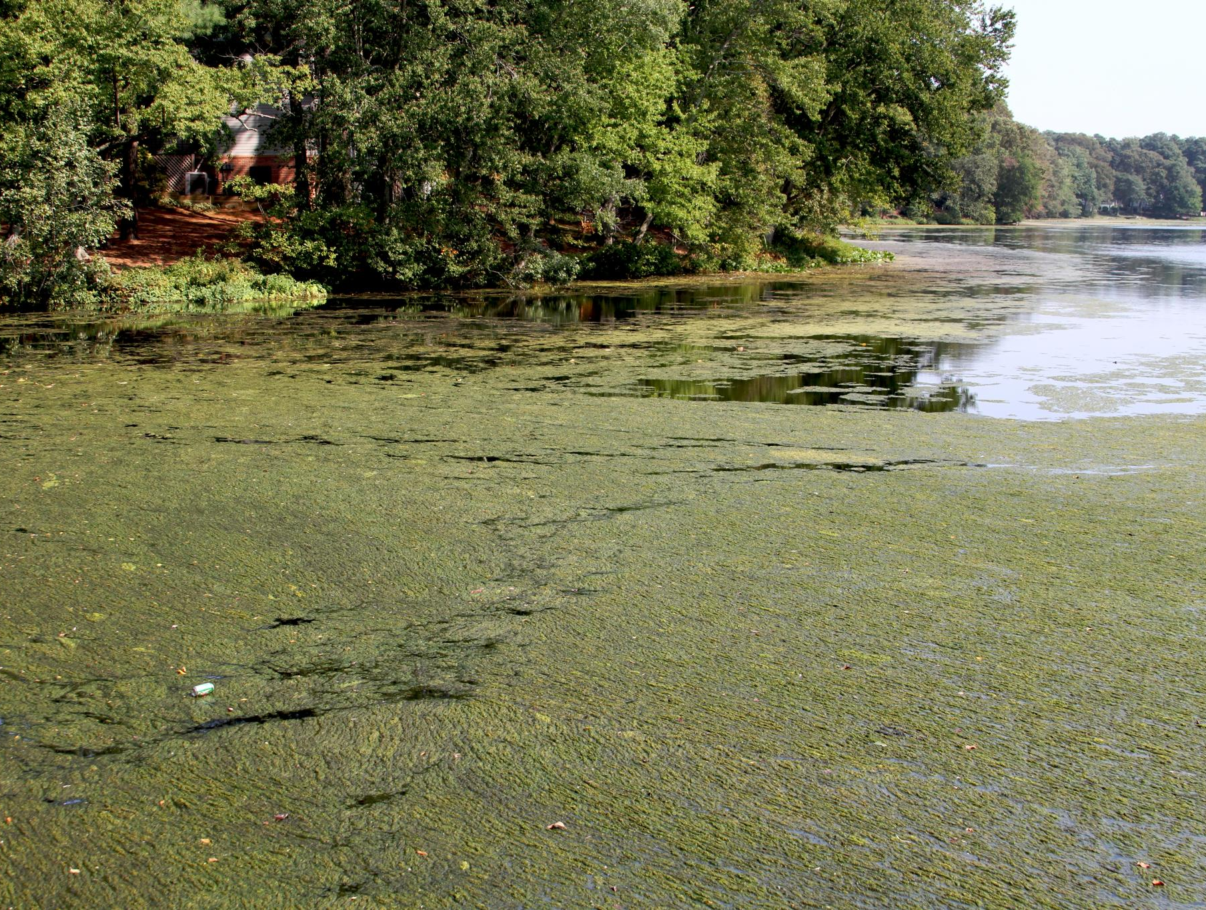
The Problem
Nitrogen and phosphorous from human activities are polluting the Chesapeake Bay. High levels of these nutrients in runoff, wastewater, and polluted air fuel dangerous algal blooms.

Slide 2
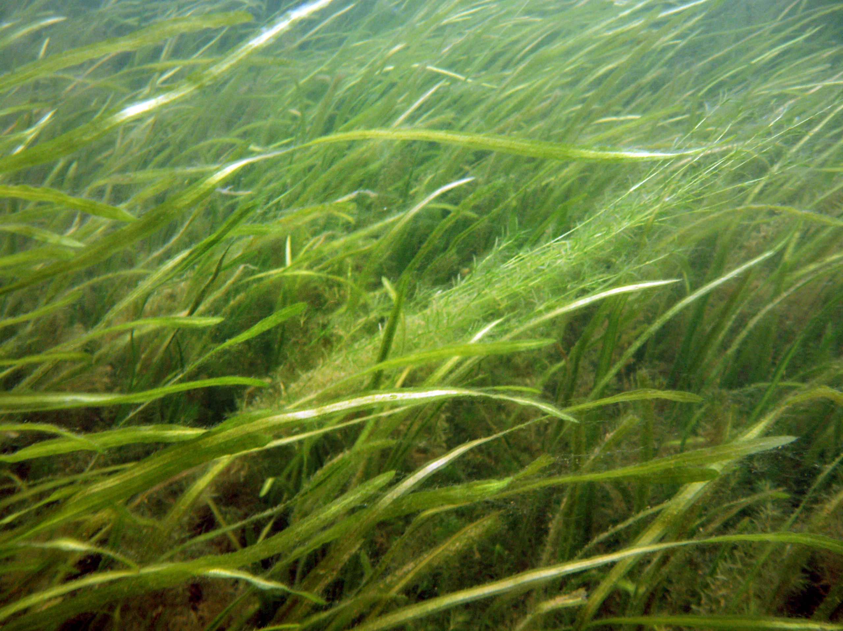
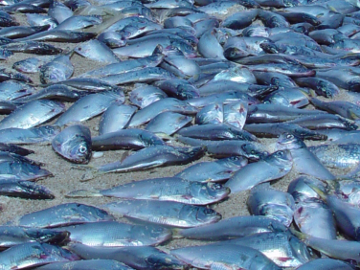
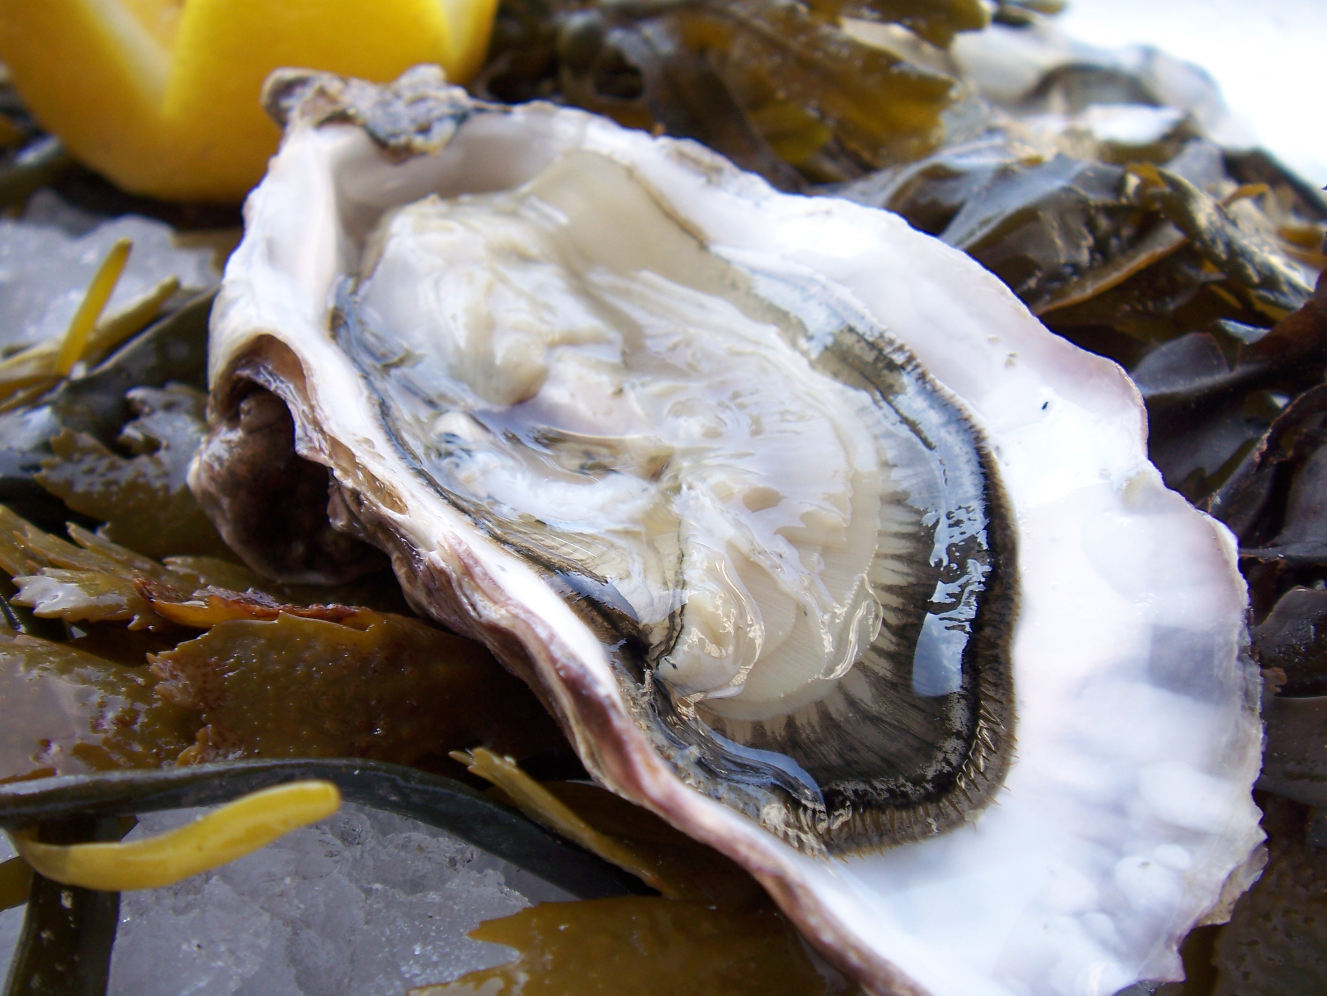
Consequences
Plant Dieoff
Algal blooms can block sunlight from aquatic grasses that provide oxygen, food, and shelter for aquatic animals.
1
Fish Kills
Algal decay eats up oxygen in the water. Without oxygen, fish, crabs, and oysters die, creating “dead zones” in the Bay.
2
Contamination
Algal blooms can produce toxins and bacteria that can sicken people through tainted water, fish, and shellfish.
3

Slide 3
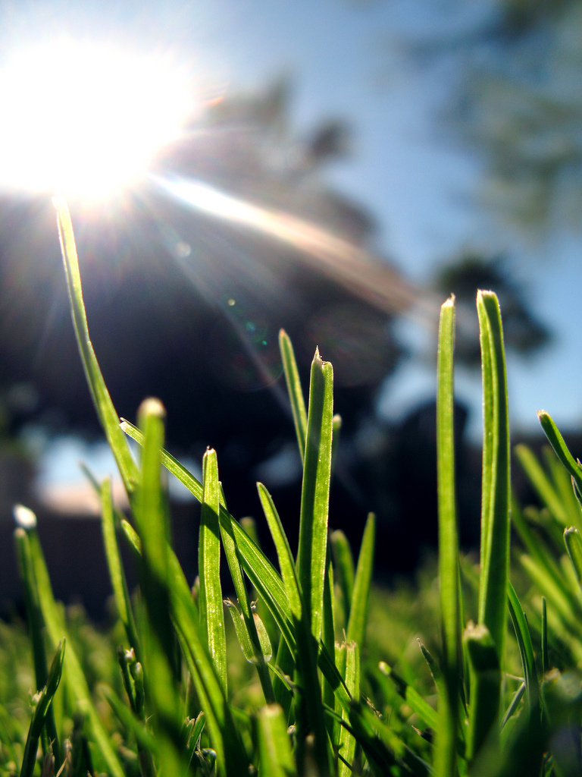
1
What Can You Do about It?
Use Less Fertilizer
Fertilizer from lawns can wash into waterways and feed algal blooms.
You can help by reducing or eliminating fertilizer use on your lawn and garden.

Slide 4
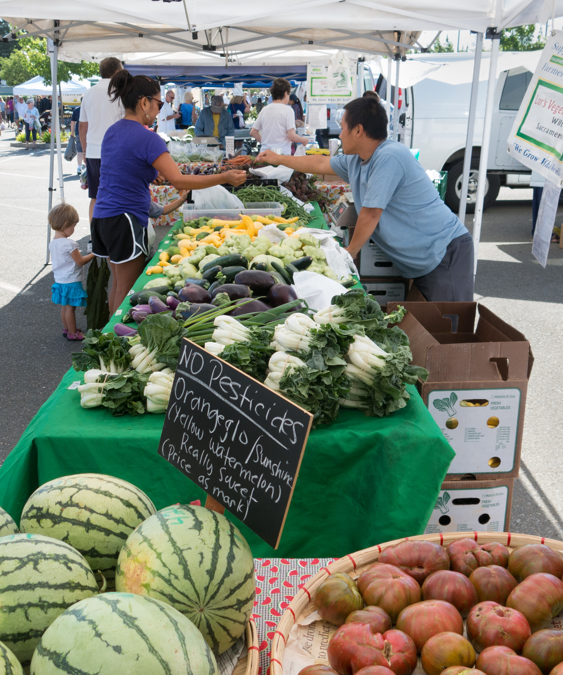
2
What Can You Do about It?
Eat Less Meat
Animal waste from poultry, hogs, and other livestock washes into waterways and is a major source of nutrient pollution.
Your food choices matter! You can reduce pollution by:
Eating less meat and dairy
Buying from local, sustainable farms
Encouraging others to do the same!

Slide 5
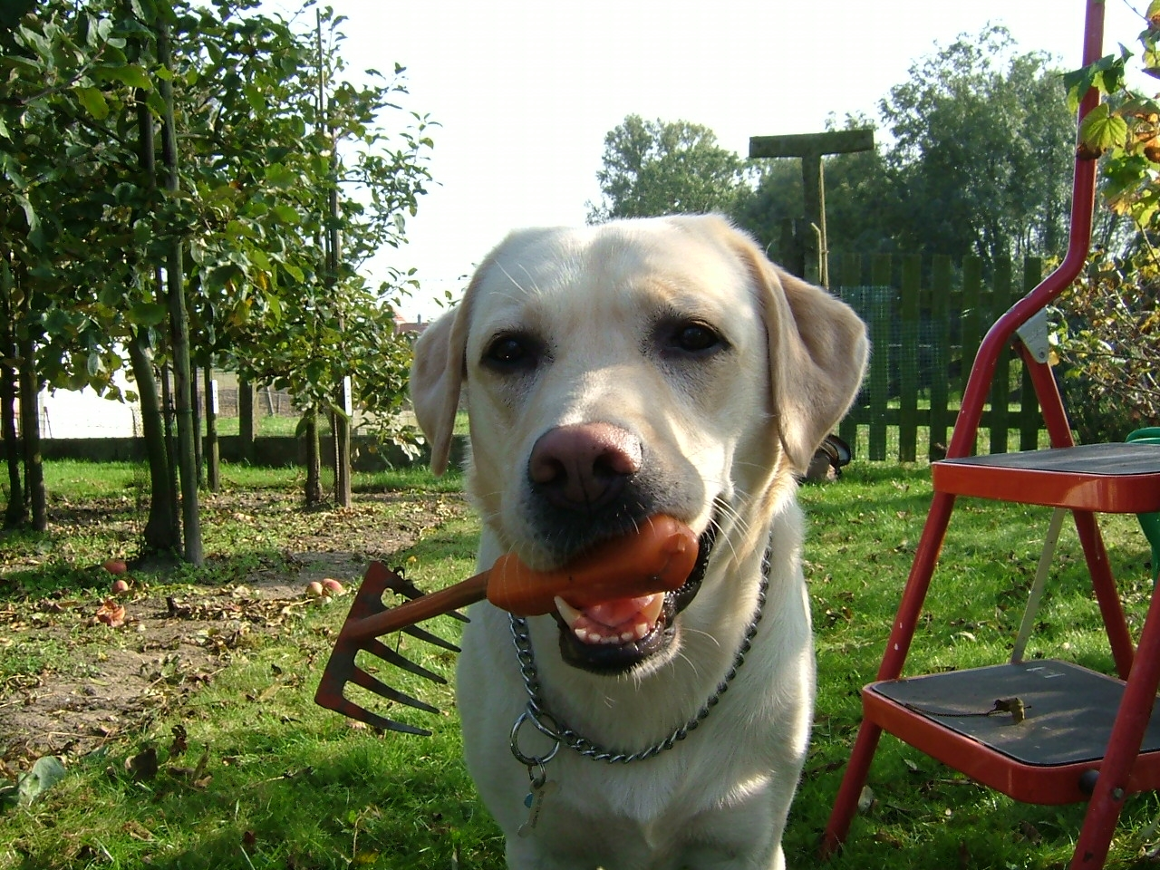
3
What Can You Do about It?
Clean Up After Pets
Pet waste contributes to nutrient pollution.
Clean up after your pet to prevent nutrients in its waste from washing into waterways.

Slide 6
Credits
Photos used under Creative Commons licenses:
https://creativecommons.org/licenses/by-nc/2.0/legalcode
“Algae on Creek” by Chesapeake Bay Program via flickr.com (cropped)
https://creativecommons.org/licenses/by/2.0/legalcode
“Menhaden Fish Kill” by eutrophication&hypoxia via flickr.com (cropped)
“An Oyster” by Mark Skipper via flickr.com
“Lawn” by Kevin Dooley via flickr.com
“Farmer’s Market” by Robert Couse-Baker via flickr.com (cropped)
https://creativecommons.org/licenses/by-nc-nd/2.0/legalcode
“Underwater Seagrasses” by University of Maryland Center for Environmental Science via flickr.com (cropped)
“Work Faster Boss! I Want to Go for a Walk” by Miss Chein via flickr.com

